Slide 1
Making a National Commodity
Peruvian Crude Cocaine, 1885-1910

Slide 2
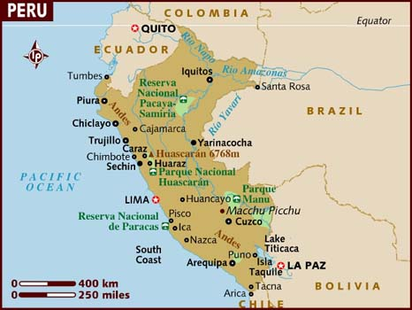
Peru

Slide 3
Anything familiar….
With these dates (1885-1910)?

Slide 4
And one more introductory question
What is a commodity?

Slide 5
“Between 1886 and 1900….
a small group of national entrepreneurs, along with localized foreign capitalists” came together in Peru to create “industrial cocaine.”
What do you think this means?

Slide 6
Peruvians….
“provided the stream of cheap cocaine that drove the drug’s larger transformation from a scientific rarity into a medical necessity and panacea and then into a mass consumption good and even globalizing drug of abuse by 1900.”
Echoes of last week here?

Slide 7
Forming a Global Market, 1885-1910
From the 1850s to 1885, no world market existed for cocaine.
In 1862, Emmanuel Merck of Darmstadt, Germany, first made cocaine hydrochloride (a numbing agent).
Name familiar?

Slide 8

Their logo….

Slide 9
Merck….
Was founded in Darmstadt in 1668, making it the world's oldest operating chemical and pharmaceutical company.

Slide 10
Merck’s work….
Came two years after chemist Albert Niemann isolated cocaine from coca leaves.
But it remained a novelty drug – why do you think that was?

Slide 11
Next major medical/chemical milestone
Surgeon Karl Koller, in late 1884, confirmed cocaine’s effectiveness for anesthesia.
This led to the take off of commercial cocaine, as it became widely used in surgeries.
Work of those like psychoanalyst Sigmund Freud saw potential for cocaine to deal with mental conditions like depression.

Slide 12
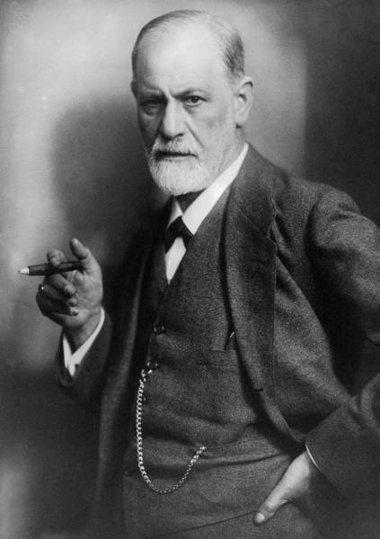
Sigmund Freud

Slide 13
The center of the commercial cocaine world?
Germany.
During the late 19th century, the Germany pharmaceutical industry consolidated.
“Cocaine was a defining good in their scientific and commercial modernization.”
So, again, it’s about more than drugs.
But there was still a problem: a scarcity of raw coca.

Slide 14
Peruvian crude cocaine
Became the answer to this scarcity.
It was an odorous, yellowish, semi-refined cake that shipped easily and retained full potency.
Merck then refined this into medicinal grade cocaine.
By 1888, cocaine had become one of Merck’s staple goods, reaching a 5,000-kilo peak in 1910 (this figured had stood at 600 kilos in 1894).
“In this way, cocaine became Merck’s single most profitable drug line in the 1890s, three-quarters of its destined for re-export, helping fuel the company’s astonishing growth and diversification into a global pharmaceutical giant.” In 2013, the company had a $1.7 billion profit.
What to make of this?

Slide 15
And as the market for medical cocaine began to stagnate….
A new kind of market emerged.
Seen as a way to impact behavior.
Was used as a way to treat opium, tobacco, and alcohol habits.
A way to also deal with things like “neurasthenia,” or nervousness often tied to urban conditions.
Also could help with sexual issues.

Slide 16
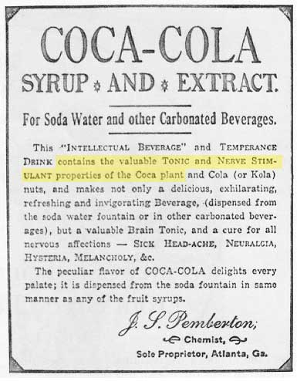
Which brings us to Coca-Cola….

Slide 17
The company….
Was started in 1886 by Atlanta pharmacist John Pemberton and was making more than $10 million a year by 1910.
Profit in 2013? $2.5 billion.
The demand for such products brought the US into the global drug trade….

Slide 18
How did all of this impact the place of origin?
Peru
As the country became known as supplier of coca, the product became a crucial part of the nation’s identity.
Had important symbolic value, but also real economic effects:
Brought about the rise of crude cocaine processing centers in Lima.
“Coca and cocaine became Peruvian commodities.”

Slide 19
Coca becomes a truly global commodity….
In 1885-6, Merck had produced only 70 kilos of cocaine, using Peruvian leaf.
Two years later this figure was up to 300 kilos.
This demand led Peru to continue to make the product a central part of their economy.

Slide 20
For the United States….
This meant domestic firms didn’t need to “grow their own” or set up processing plants on domestic soil.
Repercussions of this?

Slide 21
Peru….
“maintained its coveted national monopoly on coca and crude cocaine and set some terms of its own integration into the world drug trade….Had major powers – Britain, Germany, or the United States – acted otherwise, that is, had they moved into significant coca-cocaine ventures by the 1890s…the goods’ twentieth-century trajectories might have looked quite different.”
What do you think Gootenberg means by this?

Slide 22
What….
To make of all of this thus far?
Why am I having you read this book?

Slide 23
In 2013….
Peru was the single largest producer and exporter of cocaine in the world.
Most of the estimated 325 tons of the stuff produced each year is making its way to Brazilian and European markets, earning Peruvian organized crime well over $1 billion annually.
Such “trade” routes have benefitted others:
The illegal gold-mining industry earns almost three times as much as the drug business. Put into the mix human trafficking, the trade in illicit timber, and the trafficking of Peruvian antiquities, the earnings for organized crime in the country add up to at least $5 billion a year, perhaps closer to $7 billion.

Slide 24
What we are reading about….
Is ground zero of all of this….

Slide 25
And these countries….
Become markets for other things.
Having established a relationship with South American countries for coca leaves, Coca-Cola, for example, soon saw such places as potential consumer bases.
By 1927 it was being sold in Honduras, Colombia and Mexico, along with Haiti and Burma. The next year it debuted in Venezuela, and by 1942 it had reached Nicaragua, Argentina, Brazil, Costa Rica and Uruguay.
By the beginning of the 21st century, Mexico had the highest per capita consumption of Coke in the world.
And then as places of production.
Impact of this evolution still with us today….

Slide 26
And perhaps another kind of drug?
One that is legal….
And another kind of addiction, as briefly discussed last week?
Sugar has been shown to induce ΔFosB in D1-type medium spiny neurons in the nucleus accumbens (NAcc).
Consequently, regular consumption of large quantities of sugar can result in a state of addiction on sugar.
Implications of this?

Slide 27
The real epidemic?
More than one-third (34.9% or 78.6 million) of U.S. adults are obese.
Obesity-related conditions include heart disease, stroke, type 2 diabetes and certain types of cancer, some of the leading causes of preventable death.
The estimated annual medical cost of obesity in the U.S. was $147 billion in 2008 U.S. dollars; the medical costs for people who are obese were $1,429 higher than those of normal weight.

Slide 28
Do we need to declare….
A “War” on this?

